Slide 1
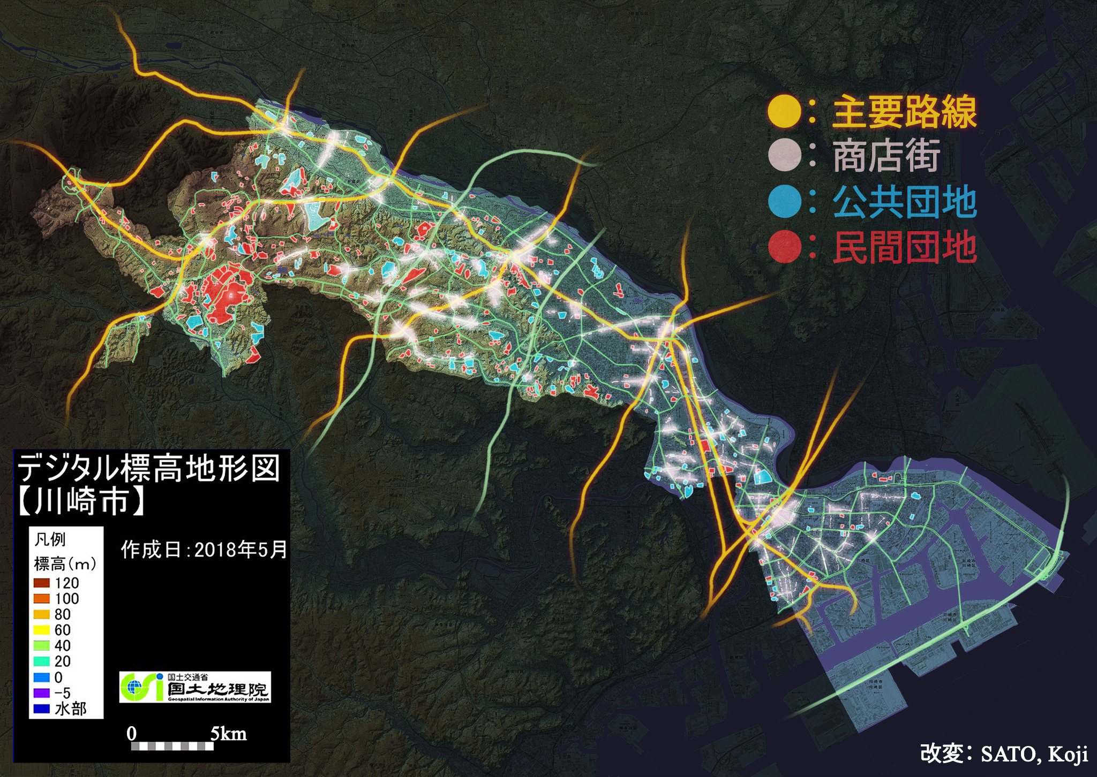
Project 3: “Data-Driven Storytelling for Civic Tech”
Koji Sato
A case study from the citizen volunteer group "Open Kawasaki."
2025/06/12

Slide 2
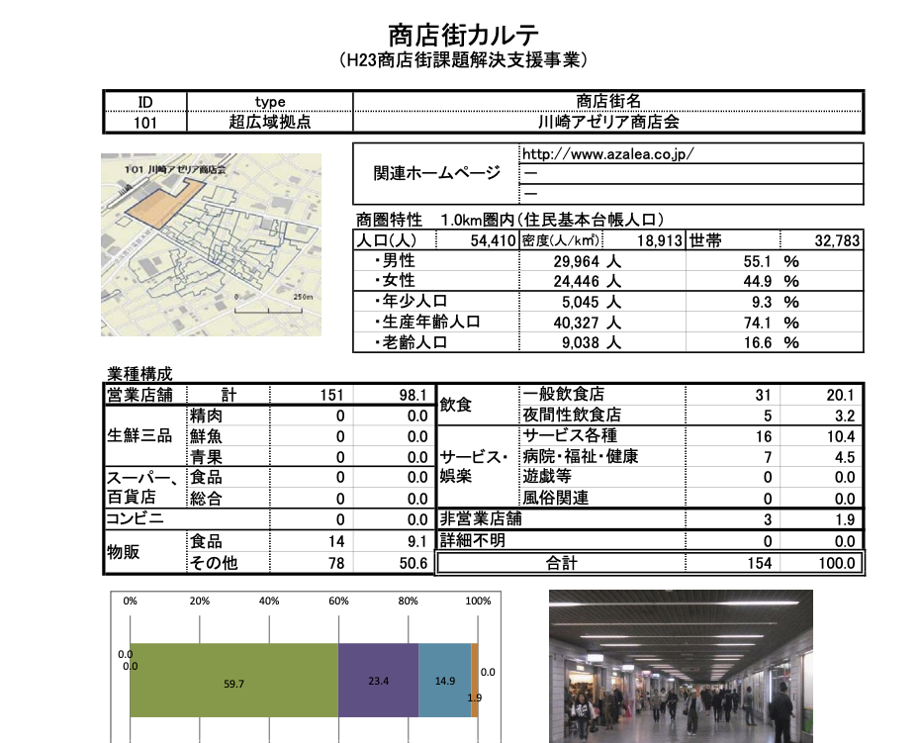
The Challenge of Open Data at the Time
Shopping District Profile
Major Railways
Shopping Districts Public Housing Complex Private Housing Complex
Digital Elevation Model [Kawasaki City]
The open data was not available as easy-to-process raw data, but only as PDF reports. Therefore, multiple data sources were synthesized using Photoshop to grasp the overall picture of the entire city.

Slide 3
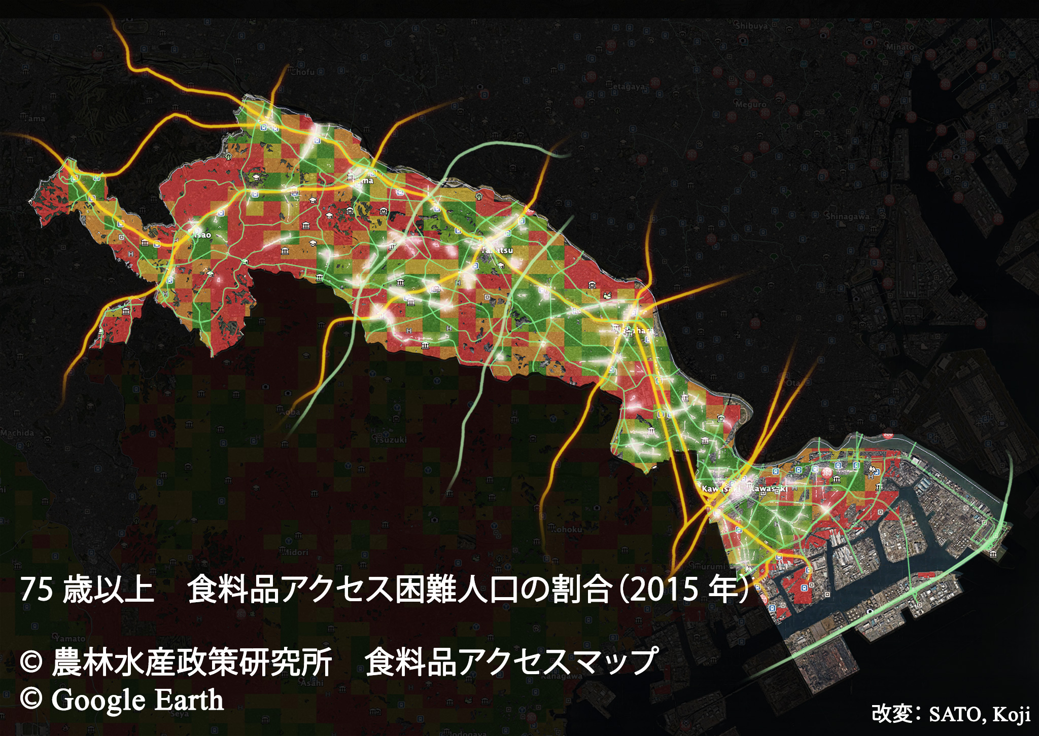
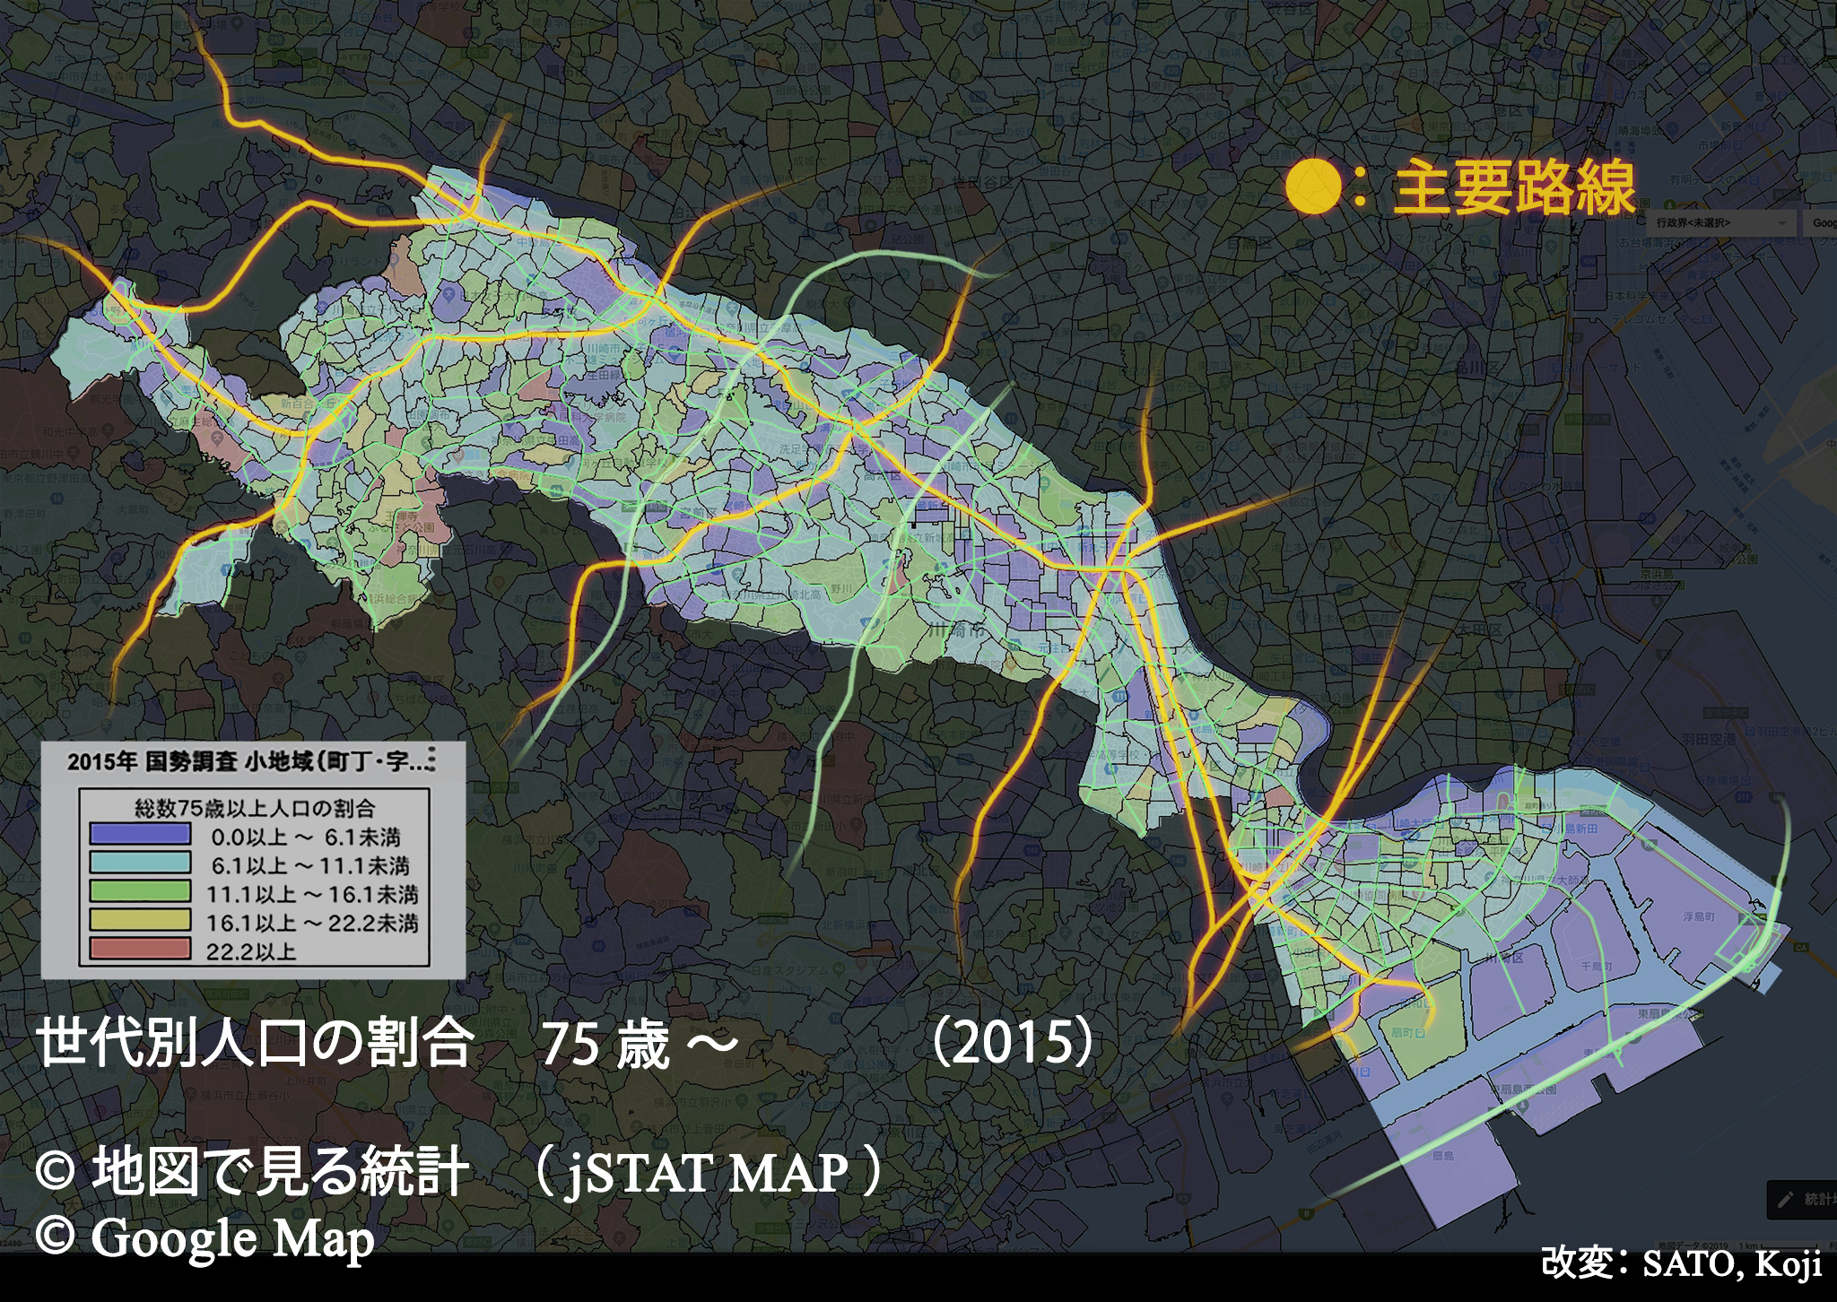
Population ratio by generation: 75 years and over (2015)
Ratio of population aged 75+ with difficulty accessing food supplies (2015)
Aiming to show overall trends by visualizing the data as a macro-level map of the entire city.
Aiming for intuitive understanding of the situation through the appropriate use of color.
Aiming for intuitive understanding of correlations by overlaying multiple data sources such as housing complex distribution, shopping district locations, and railway networks.
Aiming to clarify trends and differences between conditions by changing multiple parameters such as population.

Slide 4
Successfully achieved a clear visualization of the issue by attractively overlaying multiple sources of information on a map.

